Slide 1
CJC2302 Smart Music Teacher
Supervisor: Dr. CHAU Chuck-jee
CHENG Tsz Ying, Christy (1155157686)
CHEUNG Chi Wang, Hugo (1155158048)

Slide 2
1 Introduction
Notes:
motivation

Slide 3
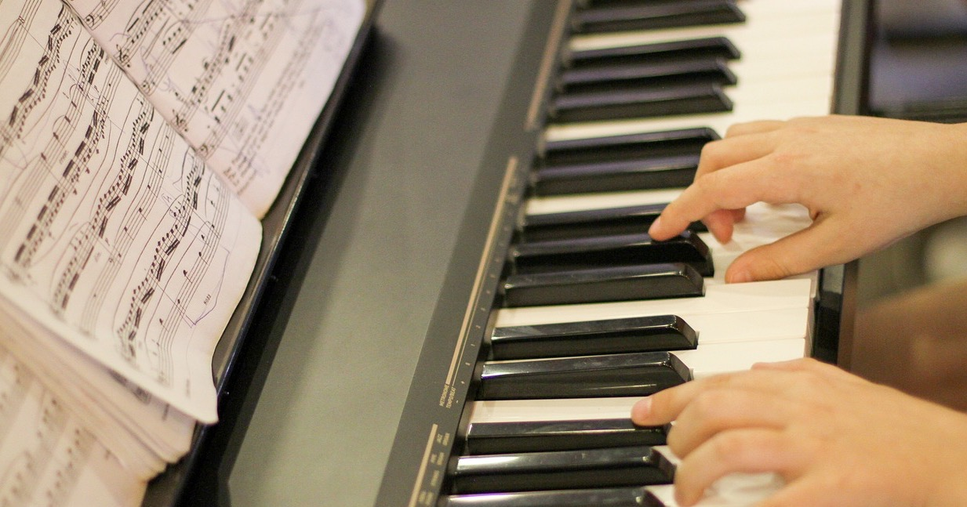
Introduction | Background | Data Collection | Solution | Result | Conclusion
Notes:
Piano Hand Playing - Free photo on Pixabay – Pixabay https://pixabay.com/photos/piano-hand-playing-piano-keyboard-3402552/
have you ever learned to play an instrument before?

Slide 4

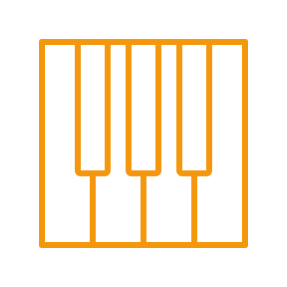

Limitations of Existing Methods
Piano Classes
Self Learning
Piano Teaching Apps
Professional Feedback
Low Accessibility
No Feedback
High Accessibility
Shallow Feedback
High Accessibility
Introduction | Background | Data Collection | Solution | Result | Conclusion

Slide 5
Limitations of Existing Methods
Shallow Feedback
Merely pitch and tempo accuracy
Lack of high-level analysis
Audio Input only
Prone to background noise
Less information to analyze
Piano Teaching Apps
Demand: accessible solution with comprehensive feedback
Introduction | Background | Data Collection | Solution | Result | Conclusion

Slide 6

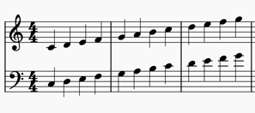

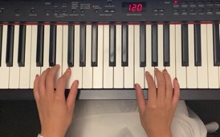
Proposed Solution
Music Score
Pitch
Tempo
Dynamics
Emotion
Style
…
Smart Music Teacher
Analytics
Piano Practice Video
Introduction | Background | Data Collection | Solution | Result | Conclusion
Notes:
1m30s

Slide 7
2 Background
Notes:
background knowledge instead

Slide 8
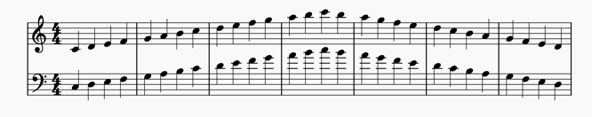
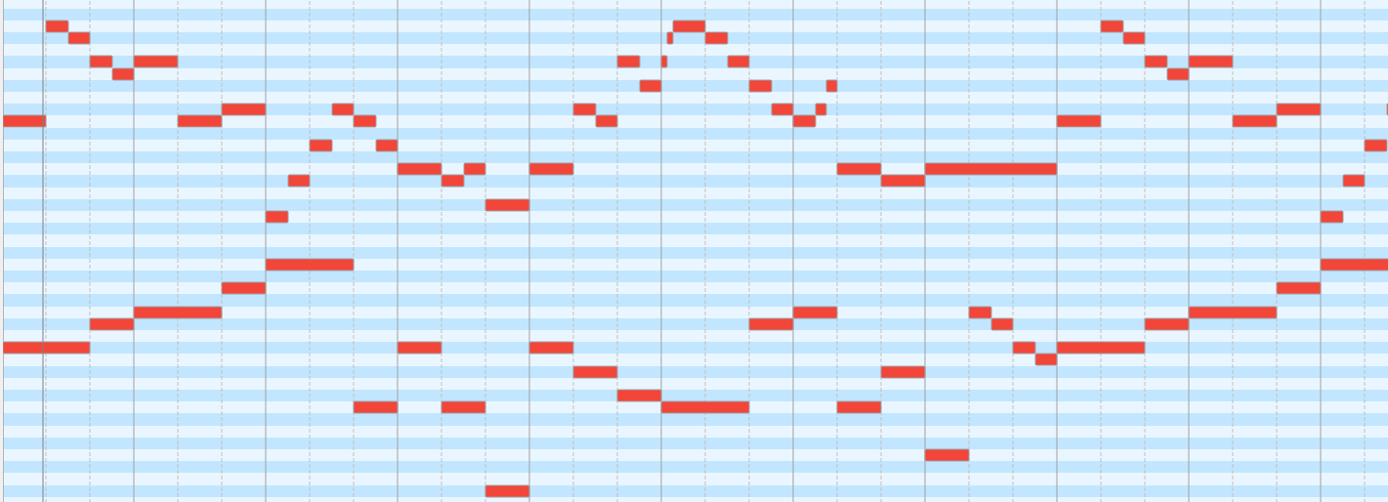
Music Representation - Symbolic
Music = a sequence of notes (pitch, duration)
Piano Score
MIDI
visual representation of notes
(pitch, duration)
→ for pianists to play a piece
digital representation of notes
(e.g. instrument, pitch, duration)
→ for computers to synthesize a piece
Introduction | Background | Data Collection | Solution | Result | Conclusion
Notes:
*

Slide 9

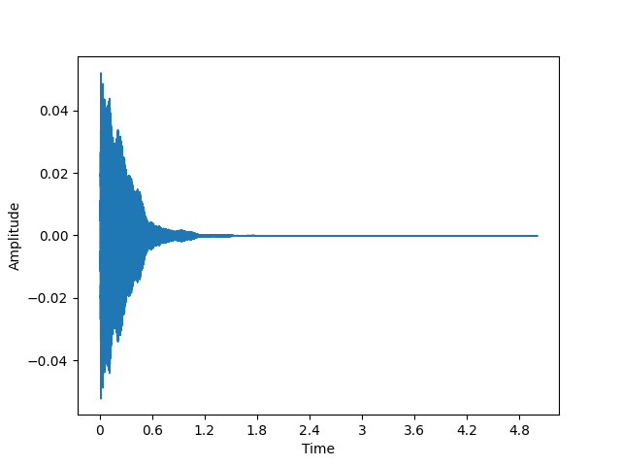
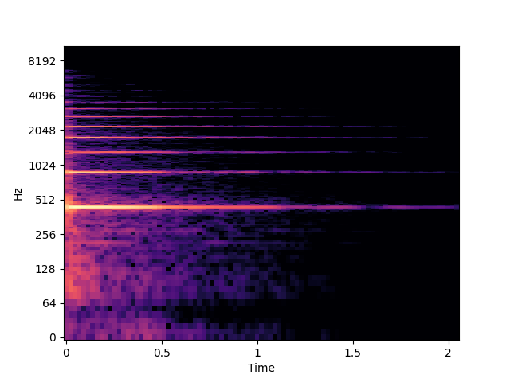
Music Representation - Audio
Sound = combination of multiple frequencies
Example: A4 Note (frequency 400 Hz)
Harmonics
Fourier Transform
Pitch we perceive (A4)
Sound Wave
Spectrogram
Wave form of audio
(Amplitude vs Time)
Separate frequencies
(Magnitude vs Frequency vs Time)
Introduction | Background | Data Collection | Solution | Result | Conclusion
Notes:
add harmonics

Slide 10
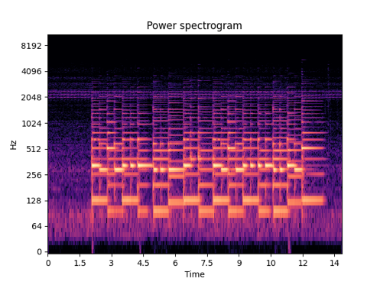
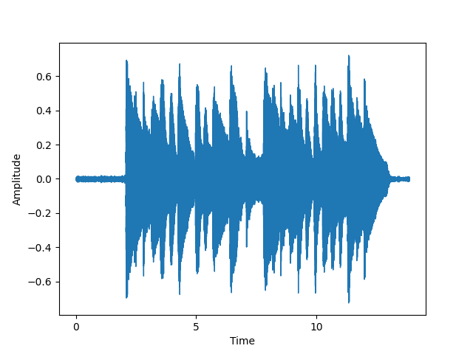
Music Representation - Audio
Extending to a piece of music
Fourier Transform
Sound Wave
Spectrogram
many notes are played
correspond to different notes played
Introduction | Background | Data Collection | Solution | Result | Conclusion

Slide 11
3 Data Collection

Slide 12
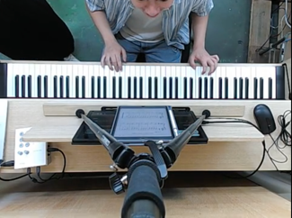
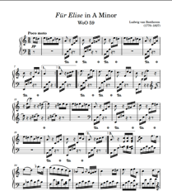
Collected Data
Recording
MuseScore
Video
Piano score
MIDI file
MIDI file
Introduction | Background | Data Collection | Solution | Result | Conclusion

Slide 13
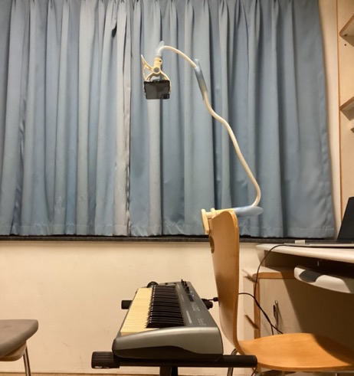
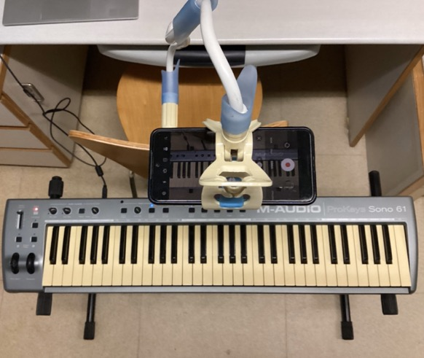
Data Recording
Side view of the set up
Top view of the set up
Introduction | Background | Data Collection | Solution | Result | Conclusion

Slide 14
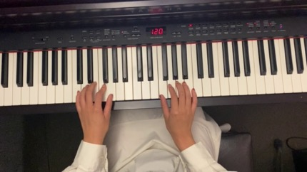
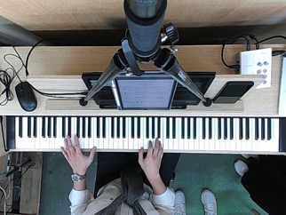
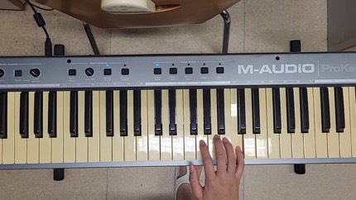
Data Recording
Venue 1 CUHK
(recorded audio)
Venue 2 Studio of Parsons Music
(synthesized audio)
Venue 3
CUHK
(synthesized audio)
Introduction | Background | Data Collection | Solution | Result | Conclusion
Notes:
Due to technical issues, the audio of piano playing for venue 1 & 3 is in form of synthesized audio.

Slide 15
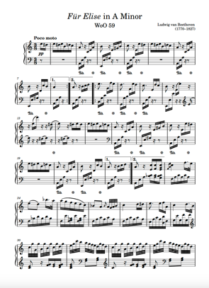
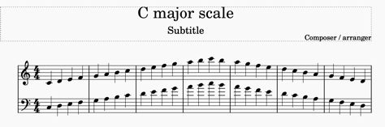
Piano Pieces
Purpose
Facilitate development and evaluate performance
10 piano pieces are selected for testing
Downloaded from MuseScore
Difficulty Encountered
Mismatch between MIDI data and piano score’s tempo
Remaking of MIDI is needed → Time consuming
Term 1: limit to 3 pieces + C Major Scale
Introduction | Background | Data Collection | Solution | Result | Conclusion

Slide 16
Selected Piano Pieces
Name | Difficulty | Tempo | Period
* C Major Scale | Easy | N/A | N/A
* Twinkle Twinkle Little Star | Easy | Slow | N/A
* Mary Had a Little Lamb | Easy | Slow | N/A
Ode to Joy | Easy | Medium | Classical - Romantic
Minuet in D Minor | Easy | Medium | Baroque
Canon in D | Intermediate | Medium | Baroque
Air on the G String | Intermediate | Slow | Baroque
* Für Elise | Intermediate | Fast | Romantic
Goldberg Variation Aria | Hard | Medium | Baroque
Moonlight Sonata (1st Movement) | Hard | Slow | Romantic
Clair de Lune | Hard | Expressive | Romantic
* Chosen pieces
Introduction | Background | Data Collection | Solution | Result | Conclusion

Slide 17
4 Solution

Slide 18
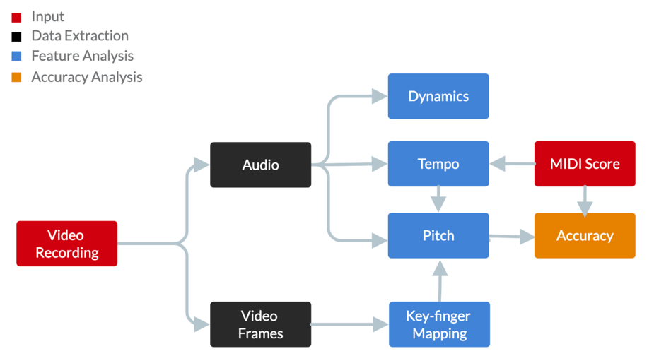
Overview
Flowchart of Term 1 implementation
Introduction | Background | Data Collection | Solution | Result | Conclusion

Slide 19
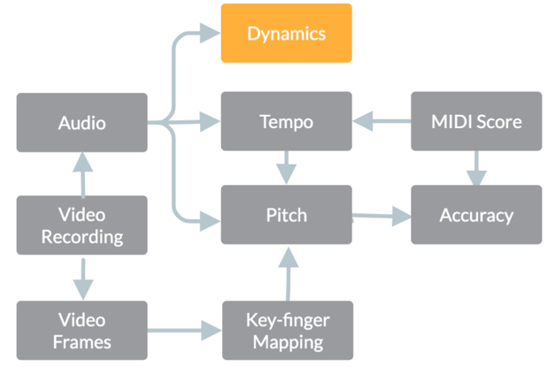
Dynamics Extraction
Introduction | Background | Data Collection | Solution | Result | Conclusion

Slide 20
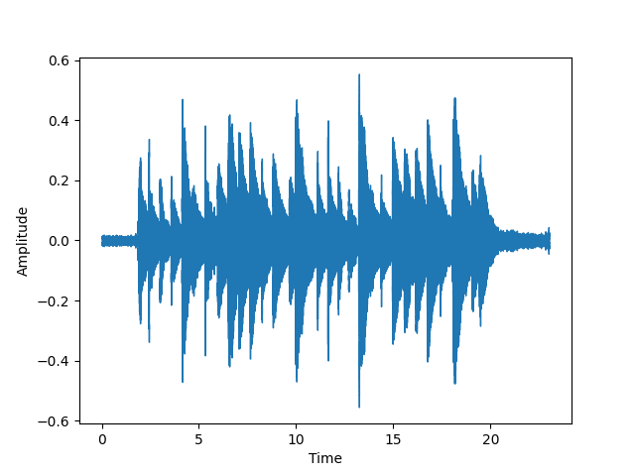
Dynamics Extraction
Dynamics = sound level (amplitude of music)
Extract amplitude information from audio
(e.g. local maximum and minimum)
Purpose
Evaluate dynamic change of piano playing
Basis for music style and emotion analysis (Term 2)
A waveform
Introduction | Background | Data Collection | Solution | Result | Conclusion

Slide 21
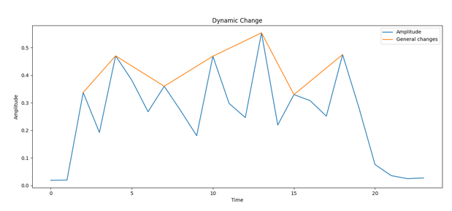





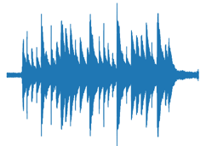
Dynamics Extraction - Methodology
Sliding window
Peak
Extraction
A waveform
Wave segments
Result
Introduction | Background | Data Collection | Solution | Result | Conclusion

Slide 22
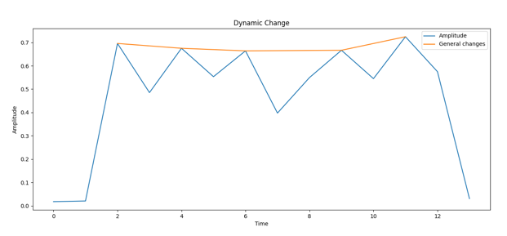
Dynamics Extraction - Evaluation
Global Amplitude Change (Orange)
Successfully detected
Local Amplitude Change (Blue)
Generally successful
Sudden changes may not be reflected
Introduction | Background | Data Collection | Solution | Result | Conclusion

Slide 23
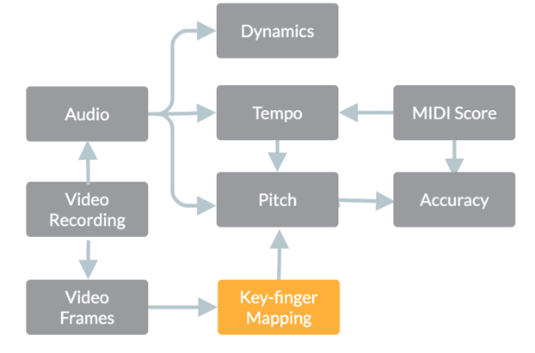
Piano Key-Finger Mapping
Introduction | Background | Data Collection | Solution | Result | Conclusion

Slide 24
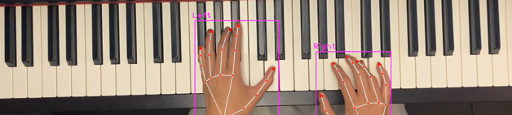
Piano Key-Finger Mapping
Track which piano key each finger is placed on
Purpose
Filter out false notes in pitch detection
Basis for piano fingering suggestion (Term 2)
 | 1 (Thumb) | 2 | 3 | 4 | 5 (Little)
Left | D4 | A#3 | A3 | G3 | F#3
Right | N/A | A4 | B4 | C5 | D5
Introduction | Background | Data Collection | Solution | Result | Conclusion

Slide 25
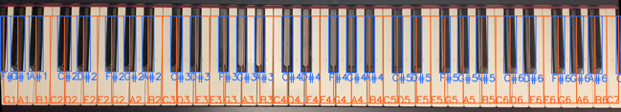
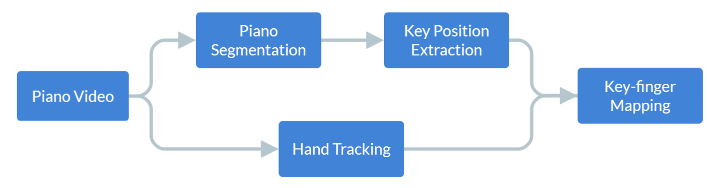
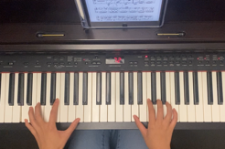
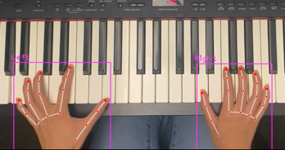
Piano Key-Finger Mapping
Introduction | Background | Data Collection | Solution | Result | Conclusion

Slide 26
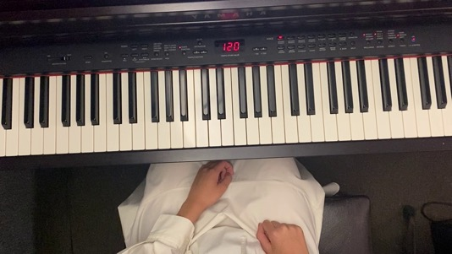
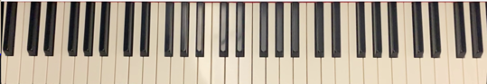
Piano Segmentation
Extract piano keyboard from a frame with a clean keyboard
Introduction | Background | Data Collection | Solution | Result | Conclusion

Slide 27
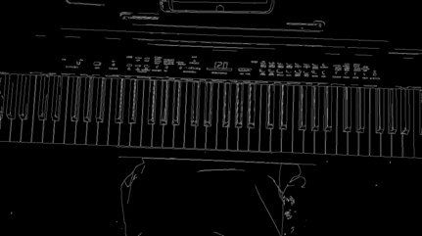
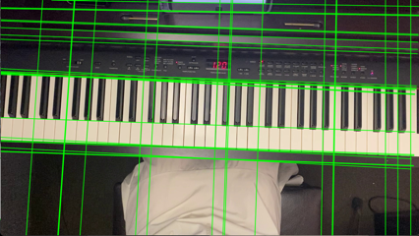
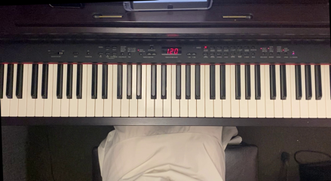
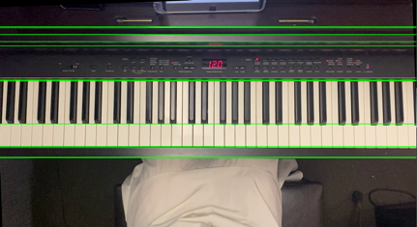
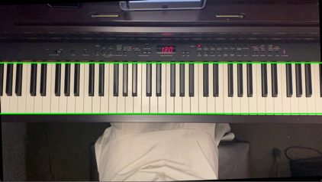
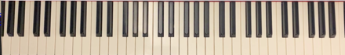
Piano Segmentation
1. Canny Edge Detection
2. Hough Transform
3. Orientation Correction
4. Candidate Boundary
5. Keyboard Boundary
6. Crop Keyboard
Introduction | Background | Data Collection | Solution | Result | Conclusion

Slide 28


Piano Key Detection
Extracted piano keyboard
Detect location and pitch of each piano key
Introduction | Background | Data Collection | Solution | Result | Conclusion

Slide 29
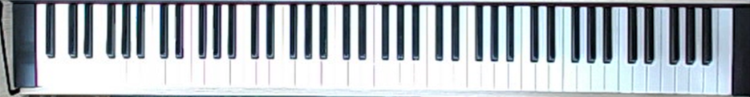
Piano Key Detection
Extracted piano keyboard
Extracted black regions by binary thresholding
Filtered connected components as black keys
Introduction | Background | Data Collection | Solution | Result | Conclusion

Slide 30
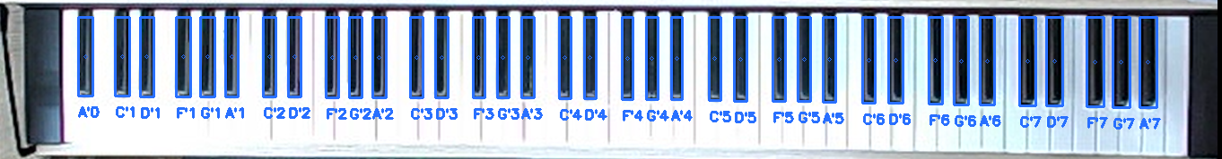
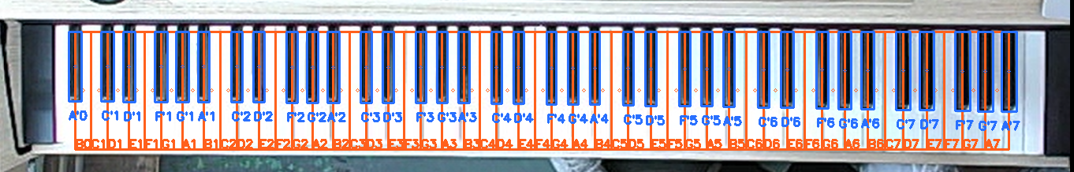
Piano Key Detection
Extracted black keys
Detect location and pitch of each piano key
Deduce white keys based on black keys' location
Introduction | Background | Data Collection | Solution | Result | Conclusion

Slide 31
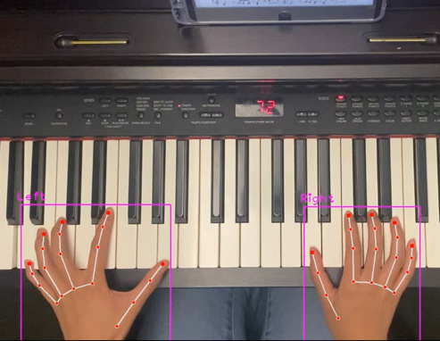
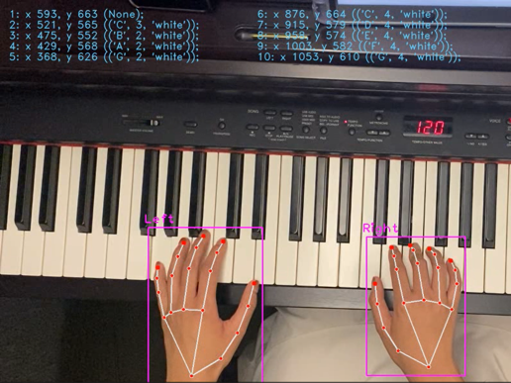
Piano Key-Finger Mapping
Hand Tracking
Map to Piano Key Location
Apply model by CVZone
→ fingertip coordinates in each frame
Obtain mapping for each frame
→ sample every 0.1 second
Introduction | Background | Data Collection | Solution | Result | Conclusion

Slide 32
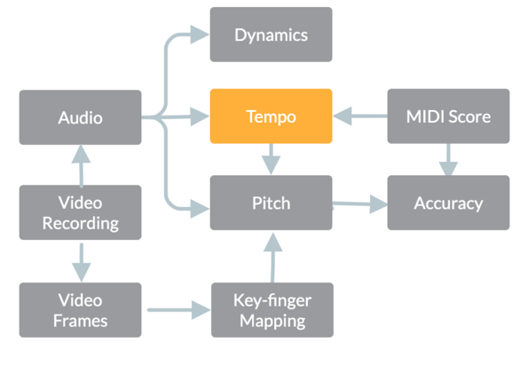
Tempo Detection
Introduction | Background | Data Collection | Solution | Result | Conclusion

Slide 33
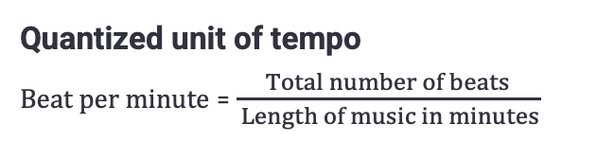
Tempo Detection
Tempo = speed of music → express feelings and interpretation of music
Extract tempo information (e.g. onsets, local pulses)
Purpose
Provide essential data for pitch detection
Basis for music style and emotion analysis (Term 2)
Quantized unit of tempo
Beat per minute = $\frac{Total number of beats}{ Length of music in minutes}$
Introduction | Background | Data Collection | Solution | Result | Conclusion

Slide 34
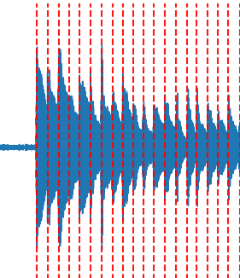
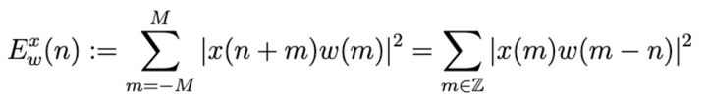
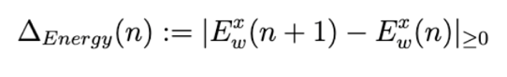
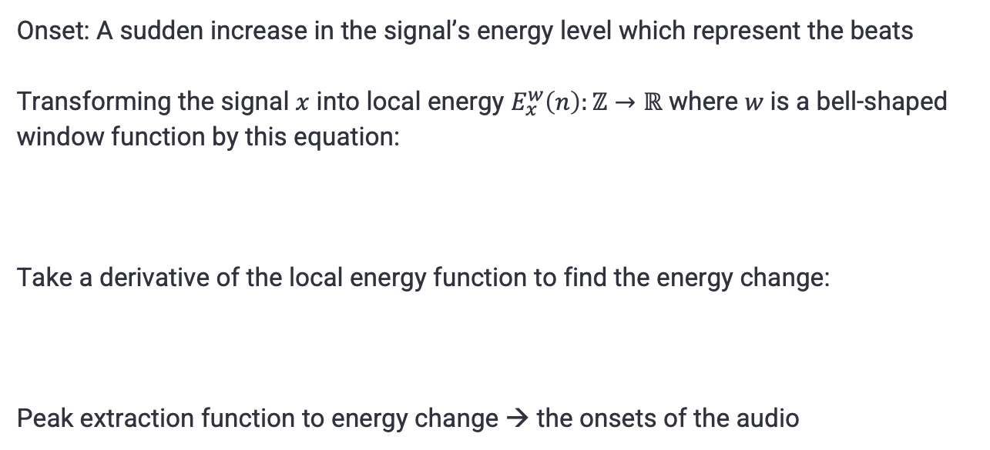
Tempo Detection - Onset Detection
Onset: A sudden increase in the signal’s energy level which represent the beats
Transforming the signal $x$ into local energy $E_{x}^{w}\left(n\right):ℤ→ℝ$ where $w$is a bell-shaped window function by this equation:
Take a derivative of the local energy function to find the energy change:
Peak extraction function to energy change → the onsets of the audio
Introduction | Background | Data Collection | Solution | Result | Conclusion

Slide 35
Tempo Detection - Predominant Local Pulse
Motivation
Expressive performances → Subjective changes in tempo → Challenging to detect
Purpose
Reduce the impact of the subjective notion of tempo and beat.
Can adjust to subjective and sudden changes in tempo.
Introduction | Background | Data Collection | Solution | Result | Conclusion

Slide 36


Tempo Detection – Graphical Representation
Onset Detection
Predominant Local Pulse
classic method for beat tracking
more “stable” tempo detection
(proper window length needed)
Introduction | Background | Data Collection | Solution | Result | Conclusion

Slide 37


Tempo Detection - Evaluation
Output
Graphical representation of tempo information
Result
Onset detection is used in Term 1
Dependency of window length in PLP
Implementation with PLP in other functions will be done in Term 2
Detected onset with spectrogram
PLP result
Introduction | Background | Data Collection | Solution | Result | Conclusion

Slide 38

Pitch Detection
Introduction | Background | Data Collection | Solution | Result | Conclusion

Slide 39


Pitch Detection
Pitch = Fundamental frequency (lowest frequency of a periodic waveform)
Detecting fundamental frequency from audio by combining visual and audio analysis
Purpose
Accuracy analysis
Introduction | Background | Data Collection | Solution | Result | Conclusion

Slide 40

Pitch Detection
Flowchart of Pitch Detection
Introduction | Background | Data Collection | Solution | Result | Conclusion

Slide 41
Pitch Detection – Monophonic & Polyphonic
Monophonic audio
Polyphonic audio
One note at a time
Simpler for pitch detection
Multiple notes at a time
Noises from harmonic spectra of multiple notes
Prone to octave errors
Introduction | Background | Data Collection | Solution | Result | Conclusion

Slide 42

Pitch Detection - Methodology
Parabolic interpolation
Computes the Fourier Transform to obtain the frequency spectrum.
Locate the highest magnitude bin and its neighbouring bins.
Applying a parabola for the interpolation to obtain the interpolated peak position.
Interpolated peak can be used for estimating the fundamental frequency
Introduction | Background | Data Collection | Solution | Result | Conclusion

Slide 43

Pitch Detection - Methodology
Onsets mapping
Segmentation
Estimates pitches by parabolic interpolation
Apply noise filtering
Map the onsets with the detected pitches
Introduction | Background | Data Collection | Solution | Result | Conclusion

Slide 44
Pitch Detection - Methodology
Filtering with visual data
Filter the false notes that are out of the piano key positions.
Hand-tracking data
 | 1 | 2 | 3 | 4 | 5
Left | N/A | E3 | D3 | C3 | B2
Right | C4 | D4 | E4 | F4 | G4
0 | B2, D4
1 | C3, E4
2 | D3
0 | B2, D4
1 | C3, E4
2 | G3
0 | B2, B4, D4, D#4
1 | C3, E4
2 | D3, G#3
Ground Truth
With filtering
Before filtering
Introduction | Background | Data Collection | Solution | Result | Conclusion

Slide 45


Pitch Detection - Methodology
Accuracy analysis
Map the MIDI data indicating the correct pitch with the detected notes
Calculate the accuracy rate by:
Missing notes are displayed with corresponding timestamp
Capture of result
Introduction | Background | Data Collection | Solution | Result | Conclusion

Slide 46

Pitch Detection - Methodology
Visualization of result
Detected notes are then visualized by converting them into a music score and image.
Visualization of detected notes
Introduction | Background | Data Collection | Solution | Result | Conclusion

Slide 47


Pitch Detection - Evaluation
Output
Graphical representation of detected notes
Result
Satisfactory result with visual filtering
Assumption of absence of pedalling notes
Sample result notated with wrong detection of notes
Introduction | Background | Data Collection | Solution | Result | Conclusion

Slide 48
Graphical User Interface
Introduction | Background | Data Collection | Solution | Result | Conclusion

Slide 49

Graphical User Interface
Detected Notes
(Piano Score)
Onset Detection Graphs
Piano Key-Finger Map
PLP Graph
Dynamics Graph
Accuracy Analysis
Introduction | Background | Data Collection | Solution | Result | Conclusion

Slide 50
5 Result

Slide 51
Pitch Detection - Accuracy
 | Venue 1 | Venue 2 | Venue 3 | Average
C Major Scale Right Hand | 100% | 100% | 100% | 100%
C Major Scale Two Hands | 89.6% | 92.1% | 91.5% | 91.0%
Mary Had a Little Lamb | 92.6% | 100% | 100% | 97.5%
Twinkle Twinkle Little Star | 82.5% | 85.3% | 86.9% | 84.9%
Für Elise | 87.6% | 88.2% | 84.9% | 86.9%
Introduction | Background | Data Collection | Solution | Result | Conclusion

Slide 52



Pitch Detection - Visualization
Detected notes of Venue 1
Detected notes of Venue 2
Score of Mary Had a Little Lamb
Introduction | Background | Data Collection | Solution | Result | Conclusion

Slide 53


Pitch Detection - Result
Ground truth
Detected notes
Introduction | Background | Data Collection | Solution | Result | Conclusion

Slide 54
Piano Key Detection
 | #Extracted Keys | #Total Keys | Accuracy
Venue 1 | 66 | 66 | 100%
Venue 2 | 85 | 88 | 96.6%
Venue 3 | 49 | 50 | 98%
 |  | Average | 98.2%
All failed keys are white keys at the edge
Detected Piano Keys (85/88, 96.6%)
Introduction | Background | Data Collection | Solution | Result | Conclusion

Slide 55


Piano Key-Finger Mapping Result
Successful piano key detection → high mapping accuracy
Common false case: thumb is at bottom edge of keyboard
 | 1 (Thumb) | 2 | 3 | 4 | 5 (Little)
Left (Truth) | G3 | E3 | D3/E3 | D3 | C3
Left (Predict) | G3 | E3 | D3 | D3 | C3
Right (Truth) | N/A | E4 | N/A | N/A | N/A
Right (Predict) | N/A | E4 | N/A | N/A | N/A
Example case
Left hand: four fingers on three white keys
Right hand: only index on keyboard, remaining fingers are not visible
Introduction | Background | Data Collection | Solution | Result | Conclusion

Slide 56
6 Conclusion

Slide 57

Conclusion
Full flowchart for the project
Introduction | Background | Data Collection | Solution | Result | Conclusion

Slide 58


Conclusion
Flowchart of Term 1 implementation
Introduction | Background | Data Collection | Solution | Result | Conclusion

Slide 59

Conclusion
Progress and future plan
Currently on track with the proposed timeline stated in planning report.
Plan to implement machine learning technique for remaining functions
Optimization of current functions
Introduction | Background | Data Collection | Solution | Result | Conclusion

Slide 60



References
Introduction | Background | Data Collection | Solution | Result | Conclusion

Slide 61


References
Introduction | Background | Data Collection | Solution | Result | Conclusion

Slide 62
Thank You

Slide 63
Q & A

Slide 64
Interpolation
In simple terms, interpolation helps to fill in the gaps between data points by estimating values for intermediate positions.
This is particularly useful when you have discrete data points and want to obtain values at positions that are not explicitly given in the data set.

Slide 65
Predominant Local Pulse
Steps of computing PLP:
Compute a Fourier tempogram from the complex Fourier coefficient of signal.
By obtaining the phase information, we can define an optimal windowed sinusoid for the signal.
With the application of the overlap-add technique, we can compute the PLP function and detect the peaks of the function to obtain the beat of audio.

Slide 66
MIDI Data
The basic message of MIDI data consists of “Note On/Off”, “Velocity”, and “Note Number”.
“Note On” denotes the starting point of a note playing
“Note Off” is the ending point of a note playing
“Velocity” refers to how fast is the key being pressed → Dynamics

Slide 67
Note Alignment
After obtaining the raw pitch information, we only have the information of which note is presented in which time frame of the audio but not the exact piano key pressing time of the notes
As we have not implemented key pressing detection from visual data yet, we map onsets of the audio with the detected note by time stamps and position of time frames appended in pitch detection.

Slide 68



Pitch Detection - Visualization
Detected notes of Venue 1
Score of Für Elise
Detected notes of Venue 3
Introduction | Background | Data Collection | Solution | Result | Conclusion

Slide 69

Fur Elise Result

Slide 70
Piano Key Detection

Slide 71


Piano Key-Finger Mapping – Venue 1
Segmentated Keyboard
Detected Piano Keys (66/66, 100% Accuracy)

Slide 72

Piano Key-Finger Mapping – Venue 2
Segmentated Keyboard
Detected Piano Keys (85/88, 96.6%)

Slide 73


Piano Key-Finger Mapping – Venue 3
Keyboard
Detected Piano Keys (49/50, 98%)

Slide 74




Piano Segmentation - Improvements
Failed at Similar Background Color
Horizontally Tilted Camera
piano's edge appears white under bright lighting
edge detection failed to extract keyboard border (orange)
extra parts were included in segmented keyboard
borders become non-parallel
→ may not extract both target borders
Possible Solutions: machine learning, use more edges for keyboard segmentation
Introduction | Background | Data Collection | Solution | Result | Conclusion

Slide 75


Piano Key-Finger Mapping – Venue 1
Ground Truth (thumb to little finger)
Left – D4, A#3, A3, G3, F#3
Right – NA, A4, B4, C5, D5
Output Video
Detected Results
Left – D4, A#3, A3, G3, F#3
Right – NA, A4, B4, C5, D5
10/10
(100% Accuracy)
Introduction | Background | Data Collection | Solution | Result | Conclusion

Slide 76



Piano Key-Finger Mapping – Venue 2
Ground Truth (thumb to little finger)
Left – G3, E3, D3/E3, D3, C3
Right – NA, E4, NA, NA, NA
Output Video
Detected Results
Left – G3, E3, D3/E3, D3, C3
Right – NA, E4, NA, NA, NA
10/10
(100% Accuracy)
Introduction | Background | Data Collection | Solution | Result | Conclusion

Slide 77



Piano Key-Finger Mapping – Venue 3
Ground Truth (thumb to little finger)
Left – NA, C3, B2, A2, G2
Right – NA, D4, E4, F4, G4
Output Video
Detected Results
Left – NA, C3, B2, A2, G2
Right – NA, D4, E4, F4, G4
10/10
(100% Accuracy)
Introduction | Background | Data Collection | Solution | Result | Conclusion

